Slide 1


SOC Lab: Wazuh SIEM
INTRODUCTION

Slide 2
Cyber sentinel: Wazuh SIEM

Slide 3
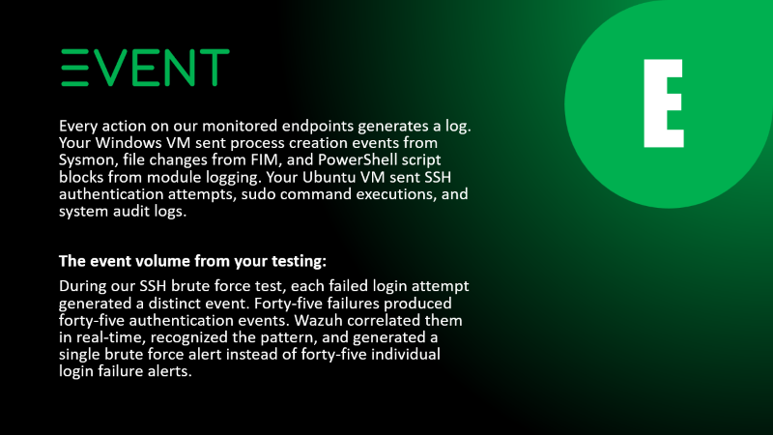
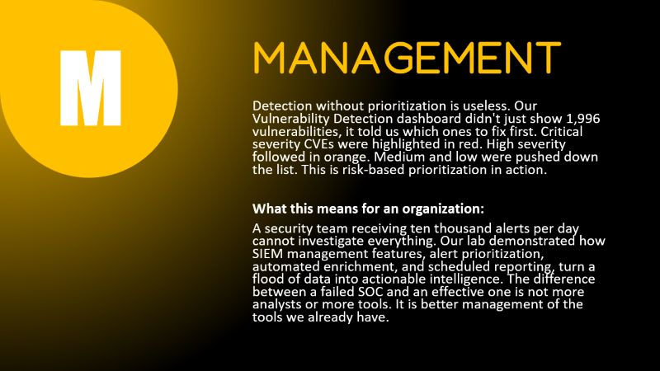
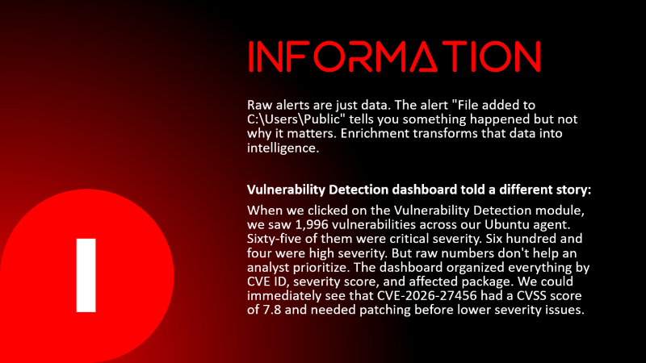
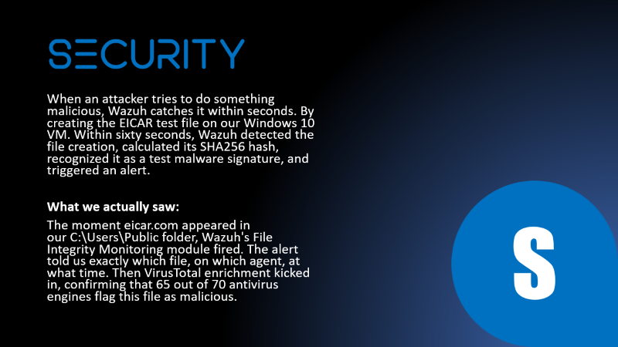

Slide 4
SECURITY
When an attacker tries to do something malicious, Wazuh catches it within seconds. By creating the EICAR test file on our Windows 10 VM. Within sixty seconds, Wazuh detected the file creation, calculated its SHA256 hash, recognized it as a test malware signature, and triggered an alert.
What we actually saw:
The moment eicar.com appeared in our C:\Users\Public folder, Wazuh's File Integrity Monitoring module fired. The alert told us exactly which file, on which agent, at what time. Then VirusTotal enrichment kicked in, confirming that 65 out of 70 antivirus engines flag this file as malicious.
S

Slide 5
INFORMATION
Raw alerts are just data. The alert "File added to C:\Users\Public" tells you something happened but not why it matters. Enrichment transforms that data into intelligence.
Vulnerability Detection dashboard told a different story:
When we clicked on the Vulnerability Detection module, we saw 1,996 vulnerabilities across our Ubuntu agent. Sixty-five of them were critical severity. Six hundred and four were high severity. But raw numbers don't help an analyst prioritize. The dashboard organized everything by CVE ID, severity score, and affected package. We could immediately see that CVE-2026-27456 had a CVSS score of 7.8 and needed patching before lower severity issues.
I

Slide 6
Event
E
Every action on our monitored endpoints generates a log. Your Windows VM sent process creation events from Sysmon, file changes from FIM, and PowerShell script blocks from module logging. Your Ubuntu VM sent SSH authentication attempts, sudo command executions, and system audit logs.
The event volume from your testing:
During our SSH brute force test, each failed login attempt generated a distinct event. Forty-five failures produced forty-five authentication events. Wazuh correlated them in real-time, recognized the pattern, and generated a single brute force alert instead of forty-five individual login failure alerts.

Slide 7
Management
M
Detection without prioritization is useless. Our Vulnerability Detection dashboard didn't just show 1,996 vulnerabilities, it told us which ones to fix first. Critical severity CVEs were highlighted in red. High severity followed in orange. Medium and low were pushed down the list. This is risk-based prioritization in action.
What this means for an organization:
A security team receiving ten thousand alerts per day cannot investigate everything. Our lab demonstrated how SIEM management features, alert prioritization, automated enrichment, and scheduled reporting, turn a flood of data into actionable intelligence. The difference between a failed SOC and an effective one is not more analysts or more tools. It is better management of the tools we already have.

Slide 8










E
M
I
Modules
S
The Circle

Slide 9
Modules
1
2
3
4

Slide 10
MITRE ATT&CK Framework
Detecting attacks is only half the battle. Understanding how an attack fits into the broader adversary playbook is what separates a reactive alert system from a proactive security operations center. Wazuh's built-in MITRE ATT&CK module automatically maps every alert to the industry-standard framework .
Modules
1
2
3
4

Slide 11


Threat Hunting
SIEMs are great at detecting known threats using rules. Threat hunting is a proactive, human-led search for unknown threats, finding the anomalies that rules might miss. Wazuh provides powerful tools for this .
Modules
2
3
4
1

Slide 12



Malware Detection
Traditional antivirus looks for known signatures. If a piece of malware is new or modified, it often slips through. Wazuh takes a multi-layered approach to malware detection, combining file integrity monitoring, behavioral analysis, and threat intelligence enrichment to catch what traditional AV misses.
2
3
4
Modules
1

Slide 13



Vulnerability Assessment
You cannot defend against what you do not know. Vulnerability assessment is the practice of continuously scanning your endpoints for known security weaknesses, outdated software, missing patches, misconfigurations and prioritizing fixes based on risk.
2
4
3
Modules
1

Slide 14






SOAR
Security Orchestration, Automation, and Response
L1 SOC automation

Slide 16
SOAR workflow
01
02
03
Mean Time to Detect (MTTD) < 60 seconds
Mean Time to Respond (MTTR) < 60 seconds
Alert Volume Processing 2000 per month

Slide 17
Analyst Time Saved
Task | Manual Time | Automated Time | Time Saved
Hash lookup | 120 seconds | 0.5 seconds | 119.5 seconds
Email notification | 60 seconds | 0.5 seconds | 59.5 seconds
MITRE mapping check | 30 seconds | 0 seconds (included) | 30 seconds
Total per alert | 210 seconds | 1 second | 209 seconds

Slide 18

Consistency and Reliability
No analyst fatigue
No missed alerts
Same every run
Predictable response every time
Zero human error
Reproducible results always
24/7 continuous operation
No shift handoff gaps

Slide 19





CONCLUSION
"Detection without response is just notification. Response without automation is just exhaustion. Automation without intelligence is just noise. This project delivered all three."

